Slide 1
Introduction to
Modern Symmetric-key
Ciphers
Dr. B C Dhara
Department of Information Technology
Jadavpur University

Slide 2
Objectives
Distinguish between traditional and modern symmetric-key ciphers
Introduce components of block ciphers such as P-boxes and S-boxes
Discuss product ciphers and distinguish between Feistel and non-Feistel ciphers
B C Dhara, Dept. of IT, JU

Slide 3
Objectives (contd…)
Discuss two kinds of attacks particularly designed for modern block ciphers:
  Differential and linear cryptanalysis
Introduce stream ciphers and distinguish between synchronous and nonsynchronous stream ciphers
Discuss linear and nonlinear feedback shift registers for implementing stream ciphers
B C Dhara, Dept. of IT, JU

Slide 4
Introduction
We have studied so far character-oriented ciphers
Bit-oriented ciphers are important as information is not just text:
  It can be number, image, audio, video, etc.
B C Dhara, Dept. of IT, JU

Slide 5
MODERN BLOCK CIPHERS
A symmetric-key modern block cipher encrypts an n-bit block of plaintext or decrypts an n-bit block of ciphertext. The encryption or decryption algorithm uses a k-bit key
Topics to be discussed
  Substitution or Transposition
  Block Ciphers as Permutation Groups
  Components of a Modern Block Cipher
  Product Ciphers
  Two Classes of Product Ciphers
  Attacks on Block Ciphers
B C Dhara, Dept. of IT, JU

Slide 6
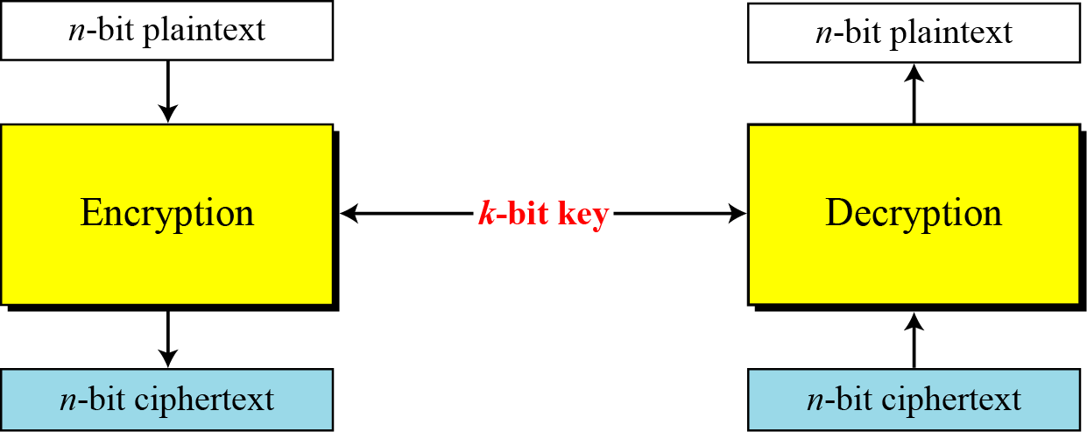
A modern block cipher
If message length less than n, extra bits must be padded to make it n-bit
block
If message length greater than n, divided into n –bit blocks with
appropriate padding to the last block
B C Dhara, Dept. of IT, JU

Slide 7
Substitution or Transposition
A modern block cipher can be designed to act as a substitution cipher or a transposition cipher
Substitution ciphers change the number of 1’s and 0’s in ciphertext
Transposition ciphers same of 1’s present in ciphertext
  which makes cipher vulnerable to exhaustive attack
To be resistant to exhaustive-search attack,
a modern block cipher needs to be designed as a substitution cipher.
B C Dhara, Dept. of IT, JU

Slide 8
5.1.1 Continued
Example 5.2
Suppose that we have a block cipher where n = 64. If there are 10 1’s in the ciphertext, how many trial-and-error tests does Eve need to do to recover the plaintext from the intercepted ciphertext in each of the following cases?
a. The cipher is designed as a substitution cipher.
b. The cipher is designed as a transposition cipher.
Solution
In the first case, Eve has no idea how many 1’s are in the plaintext. Eve needs to try all possible 264 64-bit blocks to find one that makes sense.
In the second case, Eve knows that there are exactly 10 1’s in the plaintext. Eve can launch an exhaustive-search attack using only those 64-bit blocks that have exactly 10 1’s.
5.<number>

Slide 9
Block Ciphers as Permutation Groups
We consider full-size key ciphers
Full-Size Key Transposition Block Ciphers
  For n-bits { i-th bit will mapped to j-th location}, no value change}, i.e., n-object permutation which is n!
  One key represents one permutation, so n! keys and a key is represented by ⎡log₂ n!⎤ bits
B C Dhara, Dept. of IT, JU

Slide 10
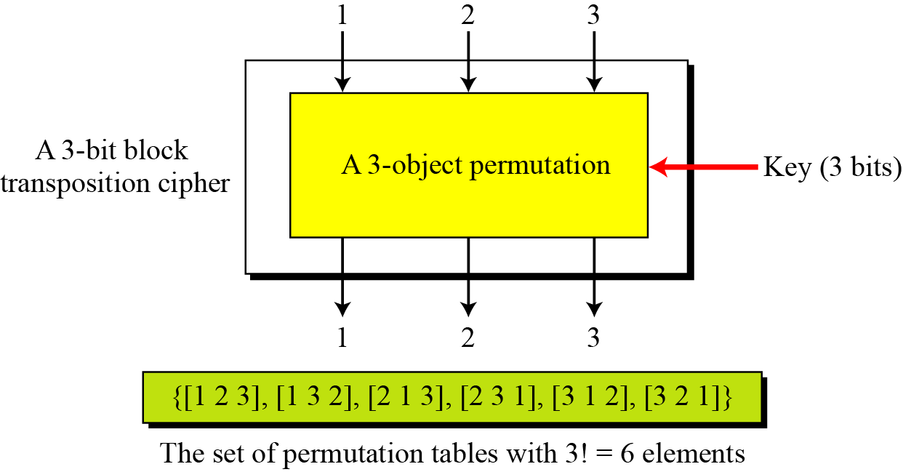
Full-Size Key Transposition Block Ciphers
Show the model and the set of permutation tables for a 3-bit block transposition cipher where the block size is 3 bits.
B C Dhara, Dept. of IT, JU

Slide 11
Full-Size Key Substitution Block Ciphers
A full-size key substitution cipher does not transpose bits; it substitutes bits.
  We can model the substitution cipher as a permutation if we can decode the input and encode the output.
Number of 1’s may get changed
n-bit input
n-bit output
n=3; (00010000), 8-length
101
100
B C Dhara, Dept. of IT, JU

Slide 12
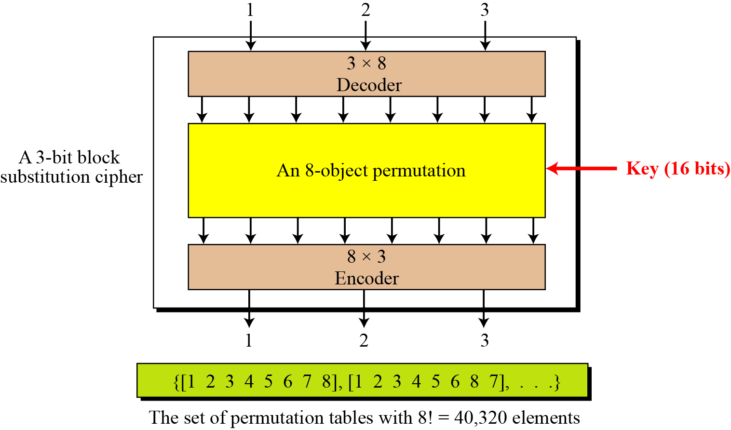

Full-Size Key Substitution Block Ciphers (contd…)
Show the model and the set of permutation tables for a 3-bit block substitution cipher
B C Dhara, Dept. of IT, JU
The key is also much longer, ⎡log₂40,320 = 16 bits

Slide 13
Full-Size Key Block Ciphers (cont…)
A full-size key n-bit transposition cipher or a substitution block cipher can be modeled as a permutation, but their key sizes are different:
Transposition: the key is ⎡log₂n! bits long.
Substitution: the key is ⎡log₂(2^{n})! bits long.
B C Dhara, Dept. of IT, JU

Slide 14
Full-Size Key Block Ciphers (cont…)
Full-size key transposition or substitution cipher is a permutation
Two or more cascaded permutations in equivalent to a single permutation
Use of more than one stage of full-size key ciphers is useless
  Because the effect is the same as having a single stage
B C Dhara, Dept. of IT, JU

Slide 15
Partial-size key ciphers
In actual ciphers full-size keys cannot use since it is too large (mainly in case of substitution)
For example,
  DES uses 64-bit block cipher
  If full-size key used, then key would be of log₂((2⁶⁴)!) =2⁷⁰ bits
  Key size of DES is 56 bits, a very small fraction of the full-size key
  DES uses only 2⁵⁶ mappings out of 2²⁷⁰ possible mappings
B C Dhara, Dept. of IT, JU

Slide 16
Keyless cipher
Independent use of keyless cipher for encryption purpose is useless
Keyless cipher can be used a components of keyed cipher
Keyless transposition cipher: P-box
Keyless substitution cipher: S-box
B C Dhara, Dept. of IT, JU

Slide 17
Components of a Modern Block Cipher
A modern block cipher is made of a combination of transposition units (P-boxes), substitution units (S-boxes) and some other units
B C Dhara, Dept. of IT, JU

Slide 18
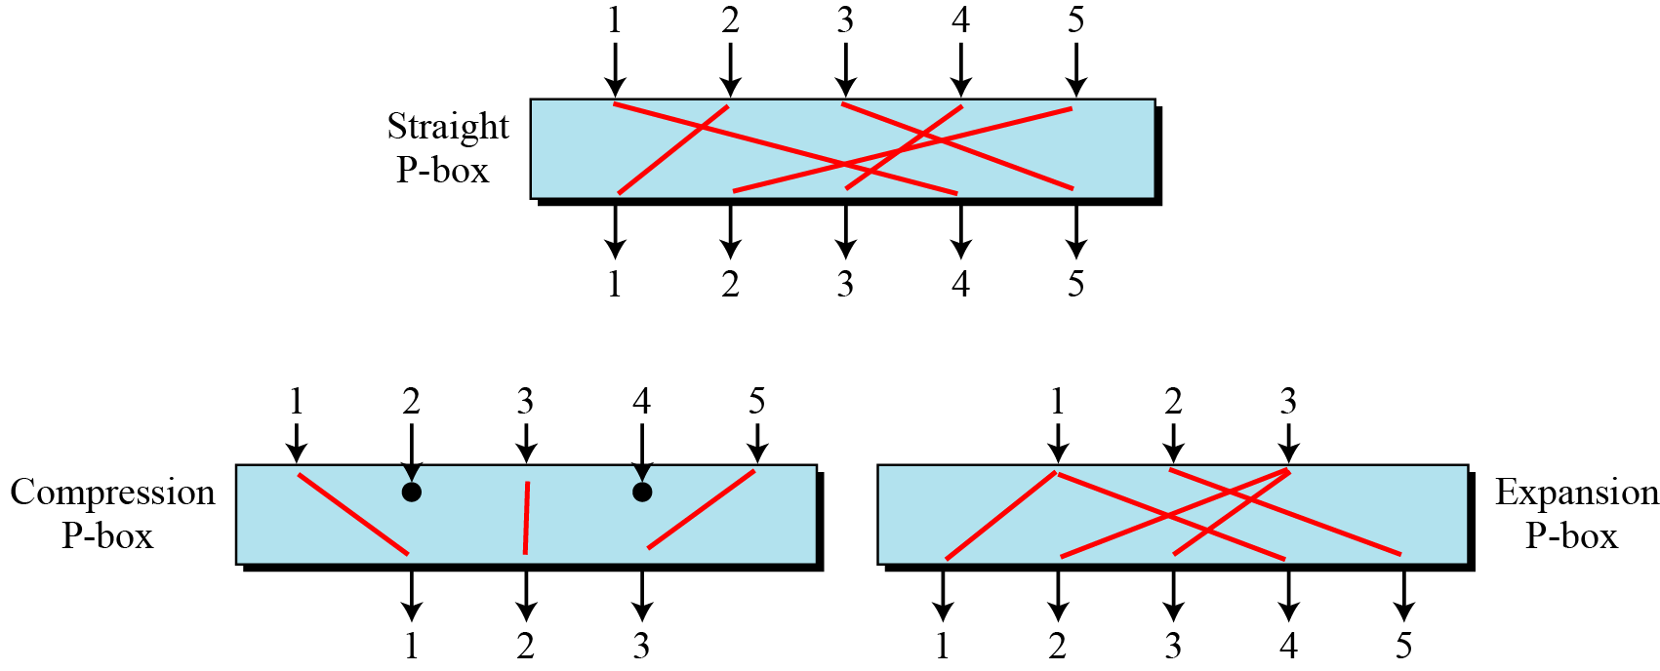
P-Boxes
We find three types of P-boxes (permutation boxes) in modern block ciphers
  Straight P-boxes
  Compression P-boxes
  Expansion P-boxes
B C Dhara, Dept. of IT, JU

Slide 19
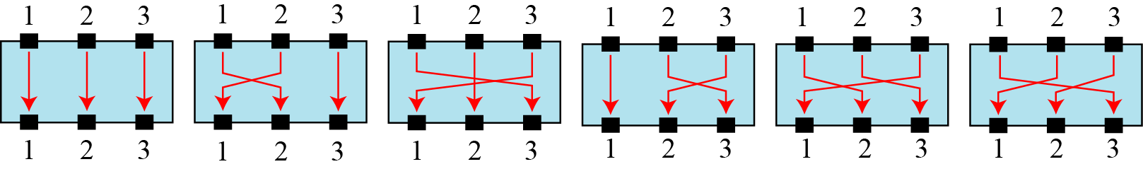
Straight P-Boxes
With n –inputs and n-outputs: a permutation
  Key less
Permutation can be represented by the index of the destination (in tabular form)
1 2 3
2 1 3
3 2 1
1 3 2
2 3 1
3 1 2
B C Dhara, Dept. of IT, JU

Slide 20
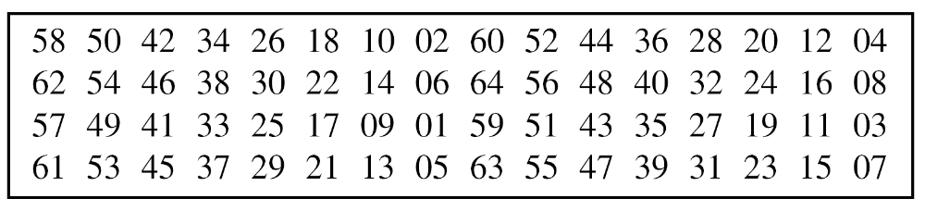
Straight P-Boxes (contd…)
n=64
B C Dhara, Dept. of IT, JU

Slide 21
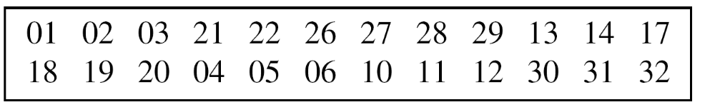
Compression P-Boxes
A compression P-box is a P-box with n inputs and m outputs where m < n
  Some inputs are blocked and do not reach to output
Example of a 32 × 24 permutation table
Some inputs are blocked: 7, 8, 9, 15, 16, 23, 24 and 25
B C Dhara, Dept. of IT, JU

Slide 22
Expansion P-Boxes
An expansion P-box is a P-box with n inputs and m outputs where m > n
Some inputs are connected to more than one output lines
Example of a 12 × 16 permutation table
B C Dhara, Dept. of IT, JU

Slide 23
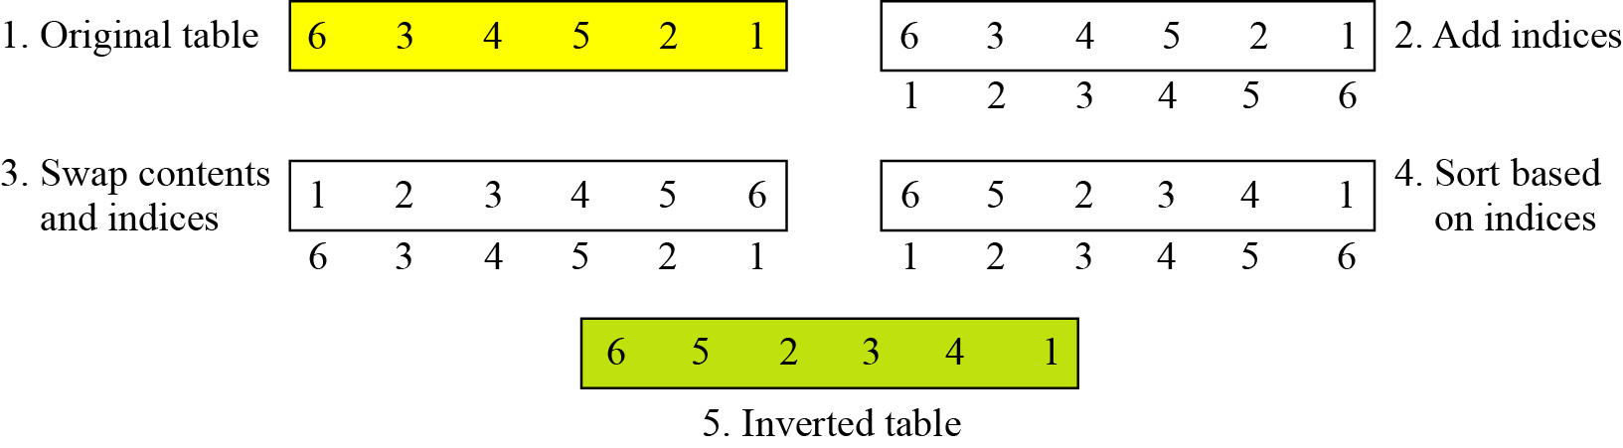
Invertibility of P-Boxes
Straight P-Box is invertible
  Invert a permutation table represented as a one-dimensional table
B C Dhara, Dept. of IT, JU

Slide 24
Invertibility of P-Boxes (contd…)
In compression P-box
  one input can be dropped during encryption
  The decryption algorithm does not have any clue how to replace the dropped bit
In expansion P-box
  An input may be mapped to more than one output during encryption
  The decryption algorithm does not have any clue which input mapped to more than one output
B C Dhara, Dept. of IT, JU

Slide 25
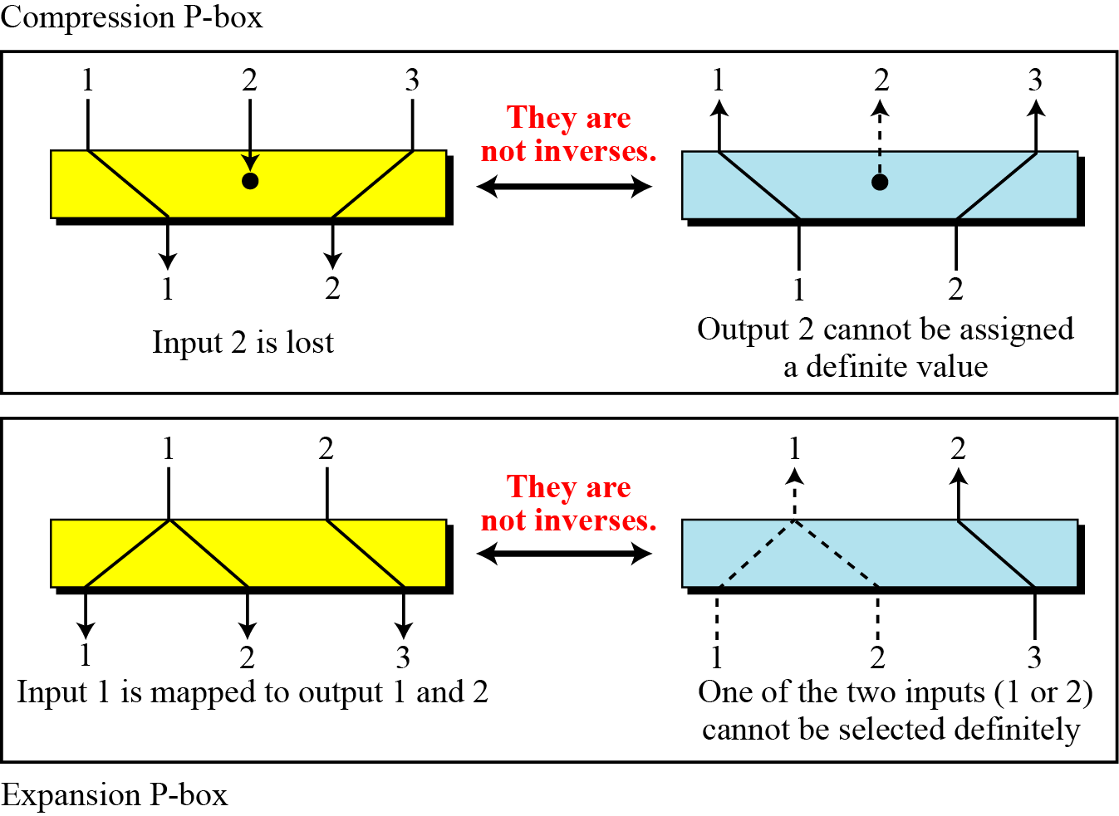
Invertibility of P-Boxes (contd…)
A straight P-box is invertible, but compression and expansion P-boxes are not.
B C Dhara, Dept. of IT, JU

Slide 26
S-Boxes
An S-box (substitution box) can be thought of as a miniature substitution cipher
S-box may be ked or keyless
  Modern block cipher normally use keyless S-box
  Mapping from input to output is predetermined
An S-box is an m × n substitution unit, where m and n are not necessarily the same.
B C Dhara, Dept. of IT, JU

Slide 27
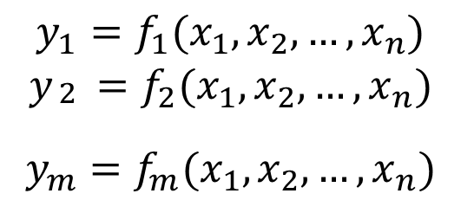
Linear/non-linear S-boxes
Relationship between input and output of S-box is defined as
B C Dhara, Dept. of IT, JU

Slide 28
Linear S-boxes (contd…)
y₁ = a₁₁x₁ ⊕ a₁₂x₂ ⊕ a₁₃x₃ ⊕ … ⊕ a_{1n}x_{n}
y₂ = a₂₁x₁ ⊕ a₂₂x₂ ⊕ a₂₃x₃ ⊕ … ⊕ a_{2n}x_{n}
y_{m} = a_{m1}x₁ ⊕ a_{m2}x₂ ⊕ a_{m3}x₃ ⊕ … ⊕ a_{mn}x_{n}
B C Dhara, Dept. of IT, JU

Slide 29
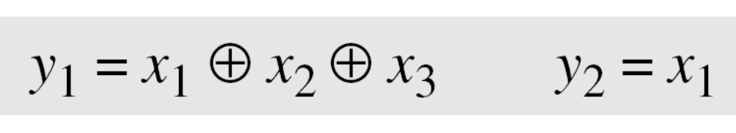
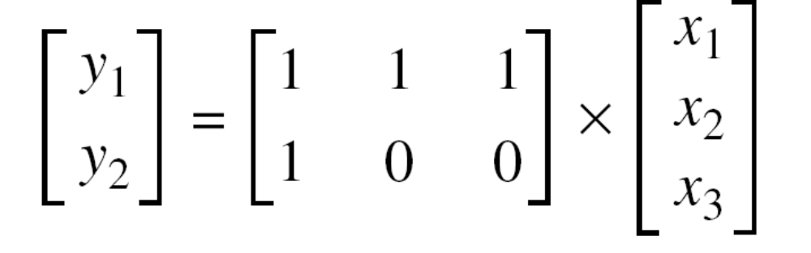
Linear S-box
In an S-box with three inputs and two outputs, we have
The S-box is linear because a_{1,1} = a_{1,2} = a_{1,3} = a_{2,1} = 1 and
a_{2,2} = a_{2,3} = 0. The relationship can be represented by matrices, as shown below:
B C Dhara, Dept. of IT, JU

Slide 30
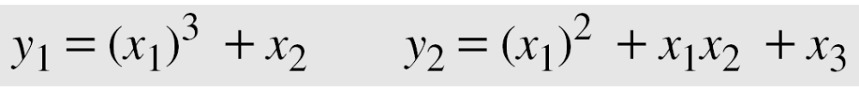
Nonlinear S-box
In an S-box with three inputs and two outputs, we have
where multiplication and addition is in GF(2). The S-box is nonlinear because there is no linear relationship between the inputs and the outputs.
B C Dhara, Dept. of IT, JU

Slide 31
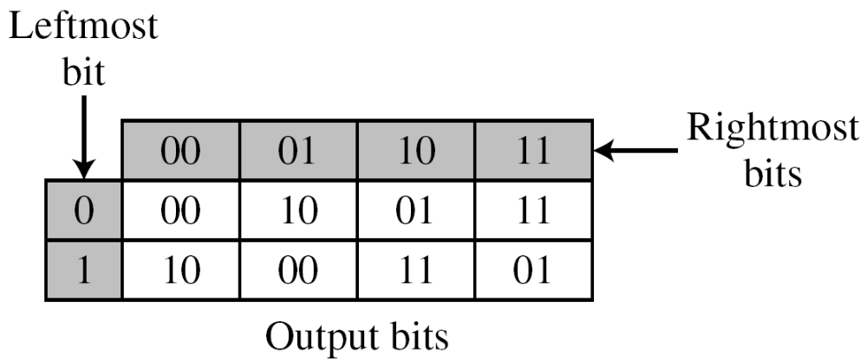
S-box (contd…)
Input/output relationship of an S-box can be represented by a table as follows (for a 3x2):
Based on the table, an input of 010 yields the output 01. An input of 101 yields the output of 00.
B C Dhara, Dept. of IT, JU

Slide 32
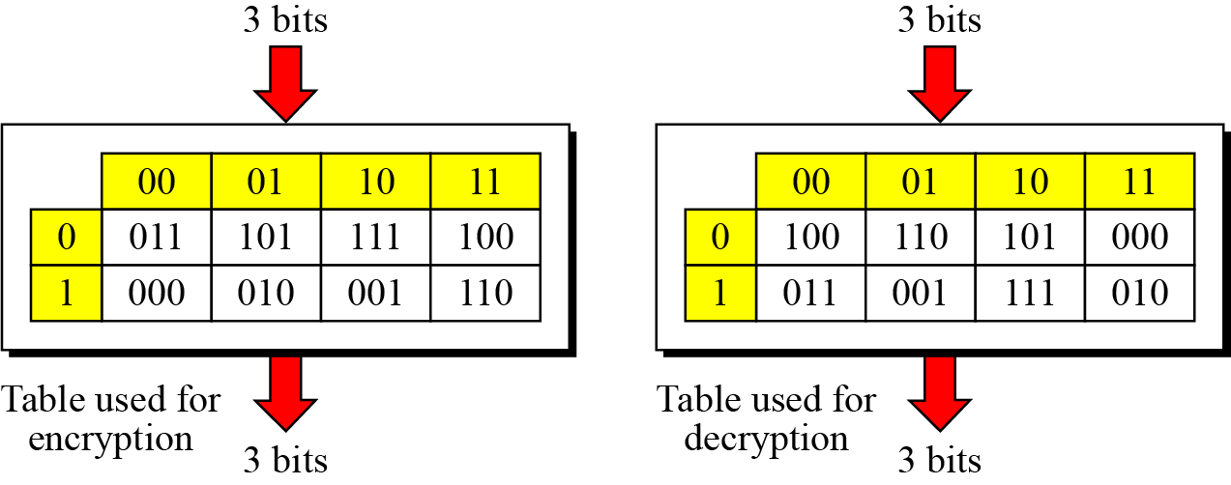
Invertibility of S-box
An S-box may or may not be invertible. In an invertible S-box, the number of input bits should be the same as the number of output bits
Above two tables are inverses of each other. For example, if the input to the left box is 001, the output is 101. The input 101 in the right table creates the output 001
B C Dhara, Dept. of IT, JU

Slide 33
XOR operation
An important component in most block ciphers is the exclusive-or operation (XOR)
Addition/subtraction in GF(2^{n}) is equivalent to XOR operation
Properties of XOR operation
Closure: two n-bit words produce one n-bit word
Associativity: (x ⊕ y) ⊕ z = x ⊕ (y ⊕ z)
Commutativity: x ⊕ y = y ⊕ x
Existance of identity: x ⊕ 0 = x
Existence of inverse: x ⊕ x = 0
Complement x ⊕ 1 = x’
B C Dhara, Dept. of IT, JU

Slide 34
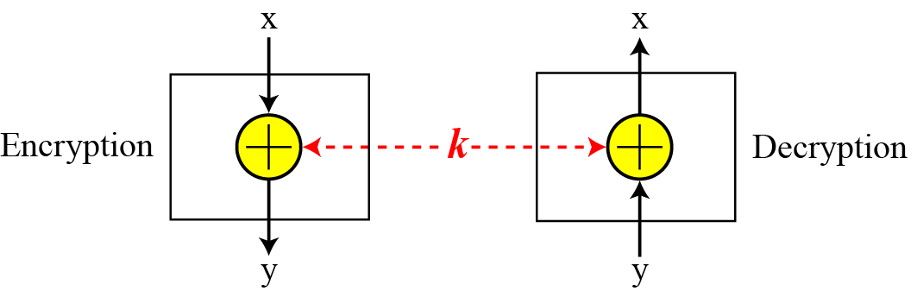
Invertibility of the XOR
XOR is self-invertible
y = x ⊕ k ⬅➔ x = y ⊕ k
B C Dhara, Dept. of IT, JU

Slide 35
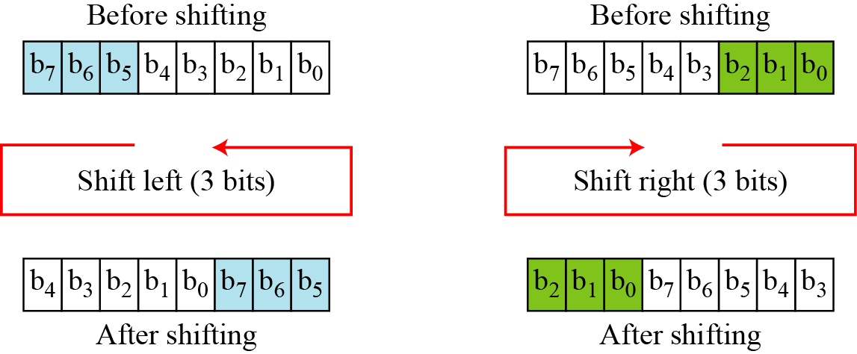
Circular shift
Circular shift is another important component of modern block cipher
  Circular left/right shift, shifting is modulo n
  Circular shift mixes bits of a word
    Hides the pattern in the original word
  Circular shift normally keyless (amount of shift is fixed)
B C Dhara, Dept. of IT, JU

Slide 36
Inverse of circular shift
Inverse of lest shift is right shift with same amount (and vice versa) OR
k-bit left shift inverse is (n-k) left shift
  Similarly for right shift
B C Dhara, Dept. of IT, JU

Slide 37
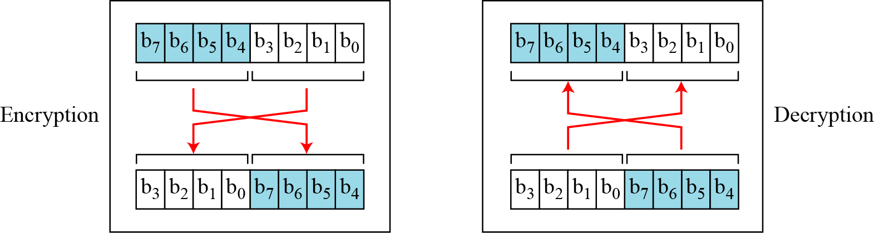
Swap operation
A special case of circular shift with k=n/2
  It is defined for even n
n/2 left shift is equivalent to n/2 right shift
  This is self-invertible
A swap operation in encryption can be totally canceled by a swap operation in decryption
B C Dhara, Dept. of IT, JU

Slide 38
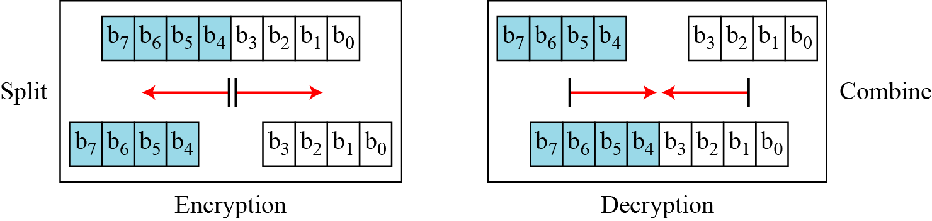
Split and Combine
These two are pair operations
  One is used in encryption and other is used in decryption
  These are inverse of each other
Split: splits an n-bit word in the middle and creates two equal length words
Combine: concatenates two equal length words to create an n-bit word
B C Dhara, Dept. of IT, JU

Slide 39
Product ciphers
A complex cipher combining substitution, permutation and other components discussed
Product ciphers have two different properties: Diffusion and Confusion
Diffusion hides the relationship between ciphertext and plaintext
This frustrate the adversary who uses ciphertext statistics to find the plaintext
Each symbol in ciphertext depends on some or all symbols in the plaintext
If a single symbol in plaintext is changed, several or all symbols in the ciphertext will be changed
B C Dhara, Dept. of IT, JU

Slide 40
Product ciphers (cont…)
Product ciphers have two different properties: Diffusion and Confusion
Confusion hides the relationship between the ciphertext and the key
This frustrate the adversary who uses ciphertext to find the key
If a single bit in the key is changed, most or all symbols in the ciphertext will be changed
B C Dhara, Dept. of IT, JU

Slide 41
Rounds
Diffusion and confusion can be achieved using iterated product ciphers where each iteration is a combination of S-boxes, P-boxes, and other components
Key schedule/ key generator creates different keys for each round
B C Dhara, Dept. of IT, JU

Slide 42
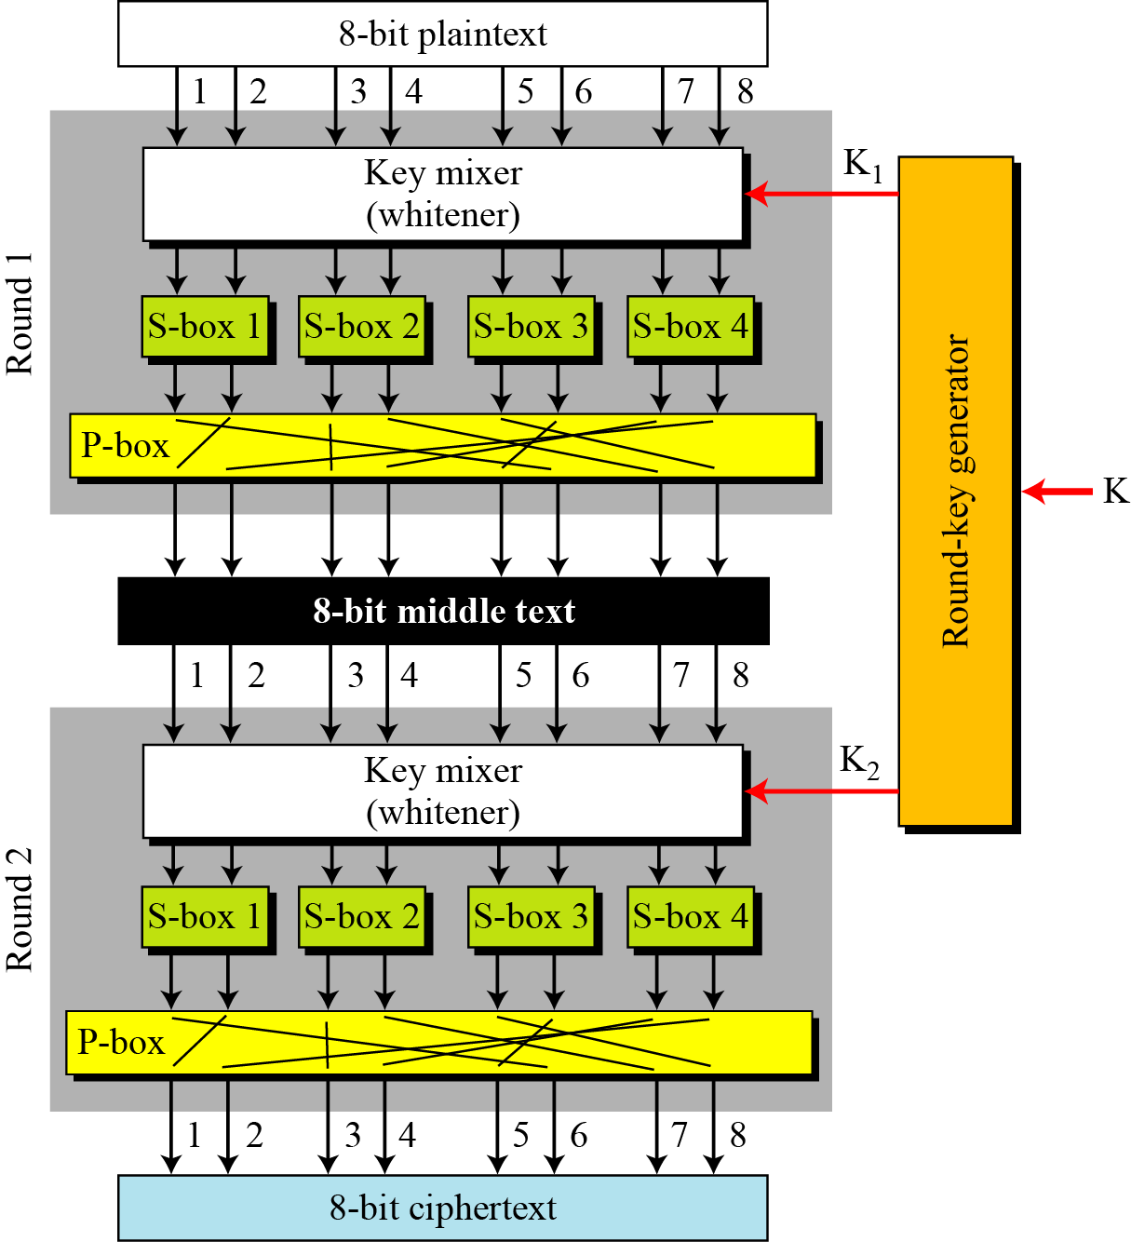
A product cipher made of two rounds
Normally done by XOR
B C Dhara, Dept. of IT, JU

Slide 43
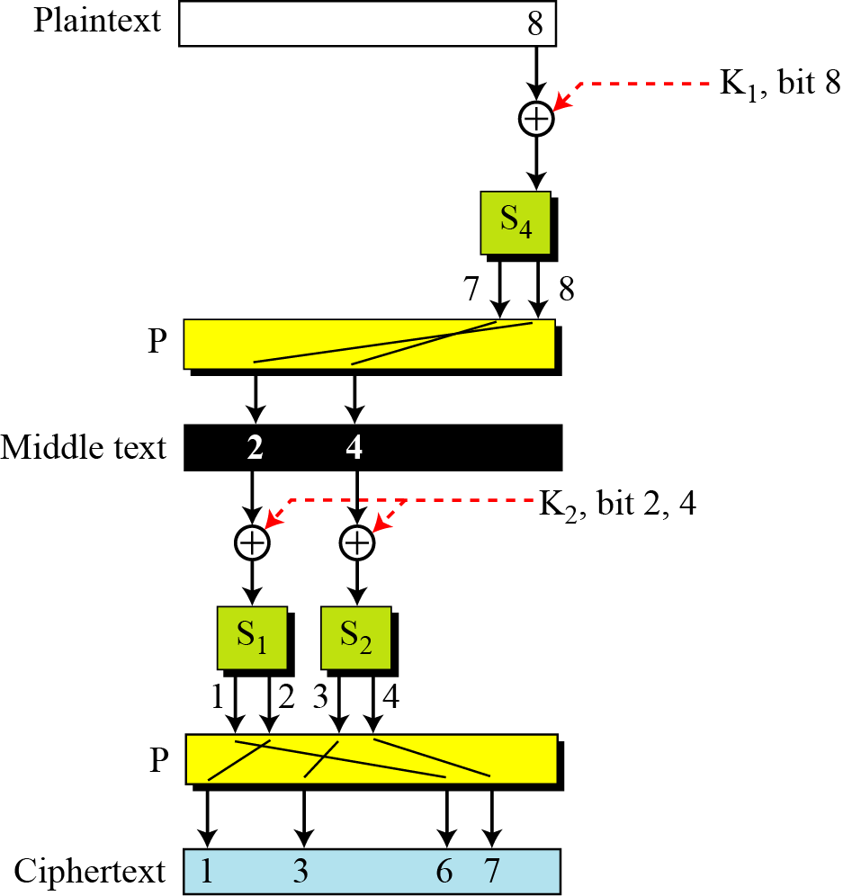
Diffusion and confusion in the block cipher
B C Dhara, Dept. of IT, JU

Slide 44
Product ciphers (cont…)
To improve diffusion and confusion:
  Practical ciphers use larger data blocks, more S-boxes, more rounds, etc.
  Increasing the number of rounds with more S-boxes may create a better cipher
B C Dhara, Dept. of IT, JU

Slide 45
Two Classes of Product Ciphers
Modern block ciphers are all product ciphers, but they are divided into two classes.
Feistel ciphers: includes both invertible and non-invertible components
Non-Feistel ciphers: only invertible components
B C Dhara, Dept. of IT, JU

Slide 46
Feistel ciphers
A Feistel cipher can have three types of components:
  Self-invertible
  Invertible
  Noninvertible: all noninvertible components combines in a unit and the same unit uses both in encryption and decryption algorithms
    How the inverse is ensured?
B C Dhara, Dept. of IT, JU

Slide 47
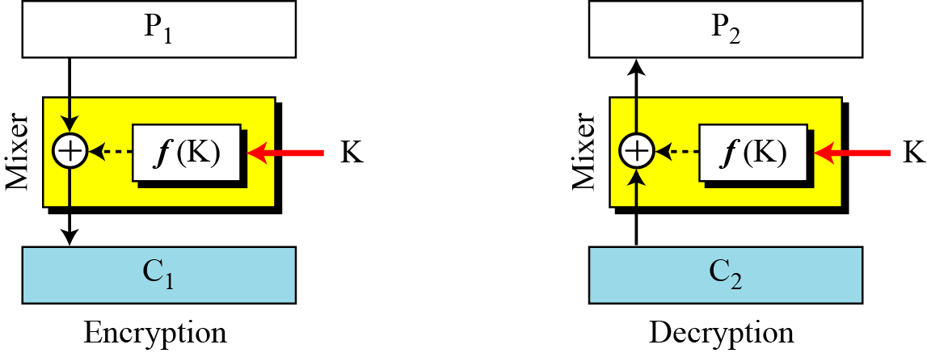
How the inverse in Feistel is ensured? First thought
This can be ensured using XOR operation
Function ‘f’ is noninvertible
Mixer is self-invertible
B C Dhara, Dept. of IT, JU

Slide 48
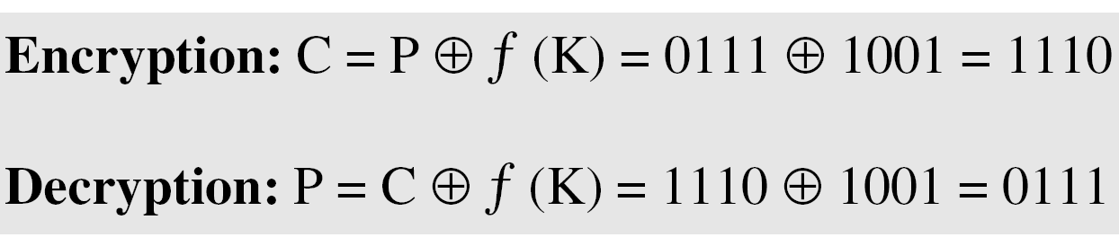
Example
The plaintext and ciphertext are each 4 bits long and the key is 3 bits long.
Assume that the function takes the first and third bits of the key, interprets these two bits as a decimal number, squares the number, and interprets the result as a 4-bit binary pattern.
The results of encryption and decryption if the original plaintext is 0111 and the key is 101.
Function ‘f’ in noninvertible: f{111,101}= 1001
The function extracts the first and second bits to get 11 in binary or 3 in decimal. The result of squaring is 9, which is 1001 in binary.
B C Dhara, Dept. of IT, JU

Slide 49
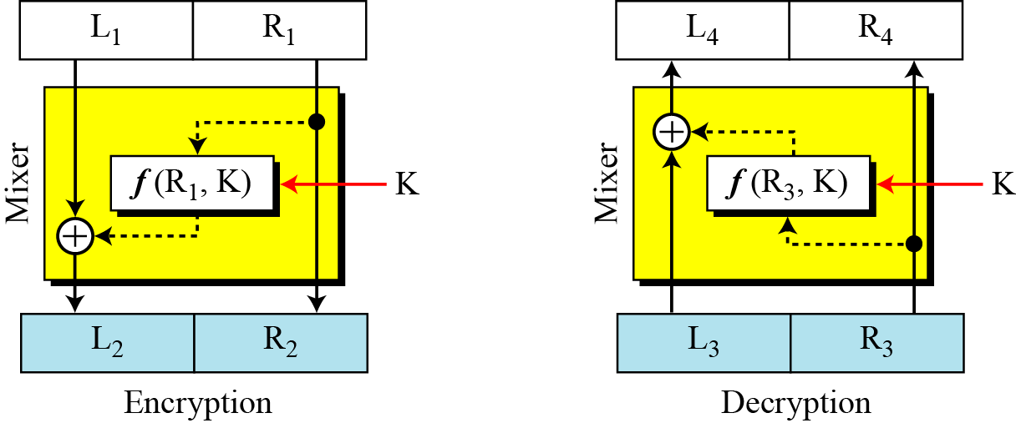
Improvement over the previous Feistel design
Consider a function two inputs:
  A part of plaintext (ciphertext), keyless
  Second input is key
For non-invertible function same input has to be given
To make this versatile, a part of input from plaintext (or ciphertext)
B C Dhara, Dept. of IT, JU
Disadvantage: right half of the plaintext never changes

Slide 50
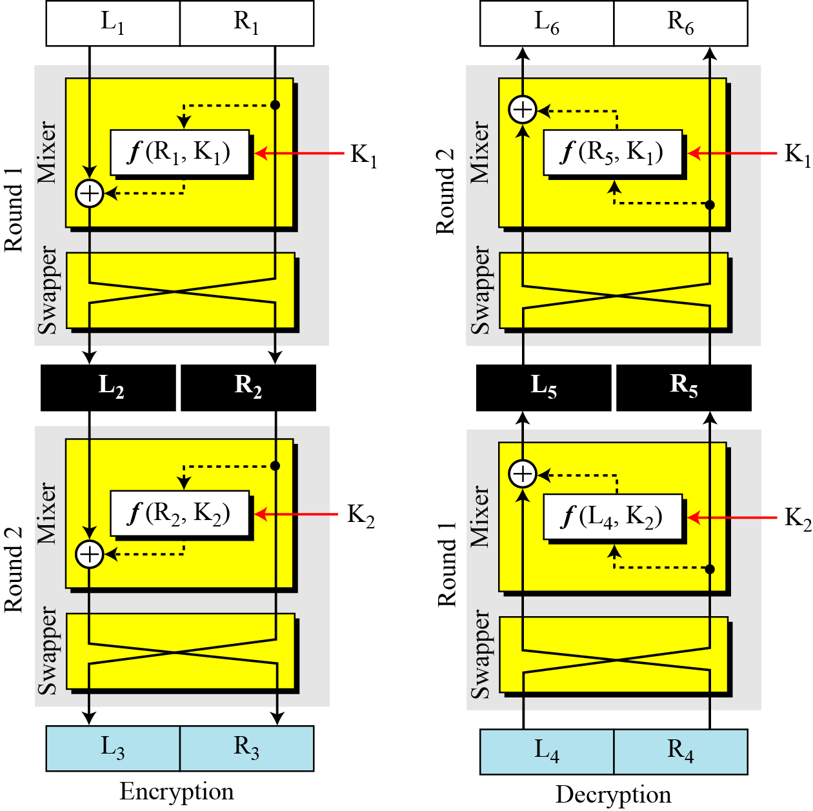
Final design of a Feistel cipher with two rounds
Needs more improvement
Increase the number of rounds
Add swaper: swaps left half and right half
  All part of the text will be changed
B C Dhara, Dept. of IT, JU

Slide 51
Non Feistel ciphers
Use only invertible components
  S-boxes with equal number of inputs and outputs
  Straight P-boxes only
B C Dhara, Dept. of IT, JU

Slide 52
Attacks on block ciphers
Modern block ciphers resist most of the tradition attacks
  Brute-force attack on the key is almost infeasible since key space is normally very large
  Considering the structure of the modern cipher, new attacks have been devised
    These attacks use differential and linear cryptanalysis techniques
B C Dhara, Dept. of IT, JU

Slide 53
Differential attacks
These are mainly based on chosen-plaintext attack
  Can access the machine of the sender, select some plaintexts and their corresponding ciphertext are computed
  Goal is to find the cipher key
Before actual attack, needs to analyze the encryption algorithm to get idea about the plaintext and ciphertext relationship
  Sometimes relationship between the plaintext difference and ciphertext difference leaking information about the key
B C Dhara, Dept. of IT, JU

Slide 54
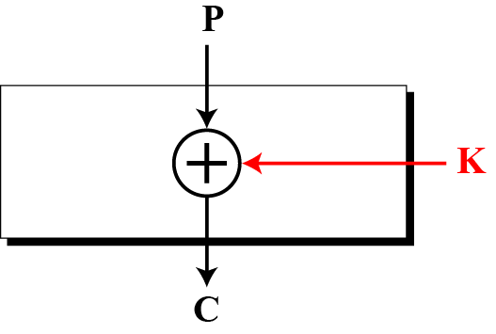
Simple attack on modern block cipher
Assume that the cipher is made only of one exclusive-or operation, as shown in below
Without knowing the value of the key, the relationship between plaintext differences and ciphertext differences can be identified
if by plaintext difference we mean P1 ⊕ P2 and by ciphertext difference, we mean C1⊕ C2
  Prove that C1 ⊕ C2 = P1 ⊕ P2
B C Dhara, Dept. of IT, JU

Slide 55
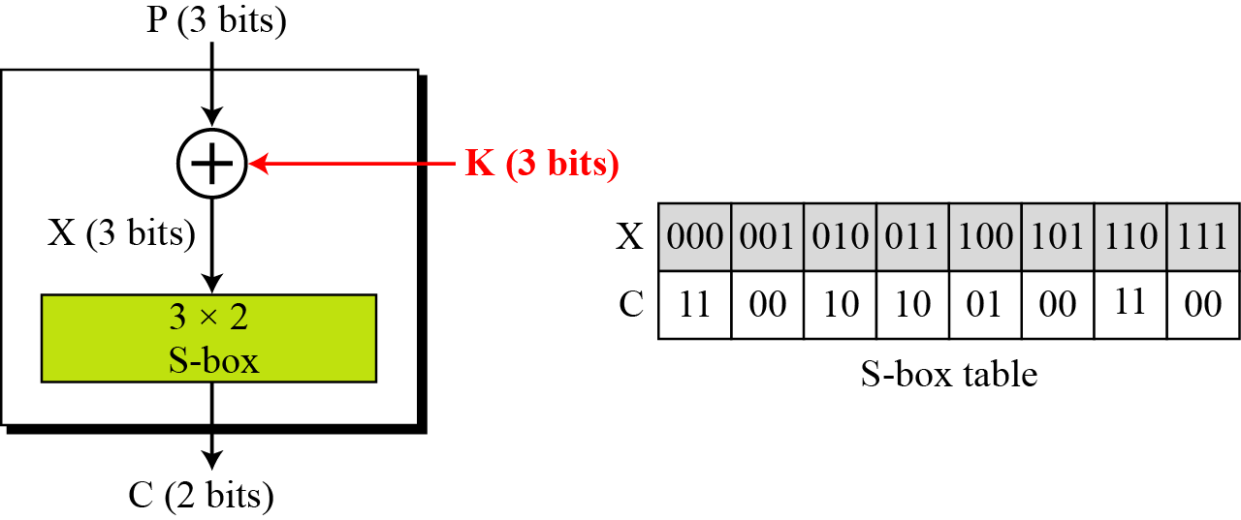
S-box added then attack on previous cipher
Non-linearity is much needed for the security of the cipher
  P1 ⊕ P2 = X1 ⊕ X2
  Existence of S-box prevents an attacker to get the relationship between plaintext and ciphertext
  A probabilistic relationship can be computed
B C Dhara, Dept. of IT, JU

Slide 56
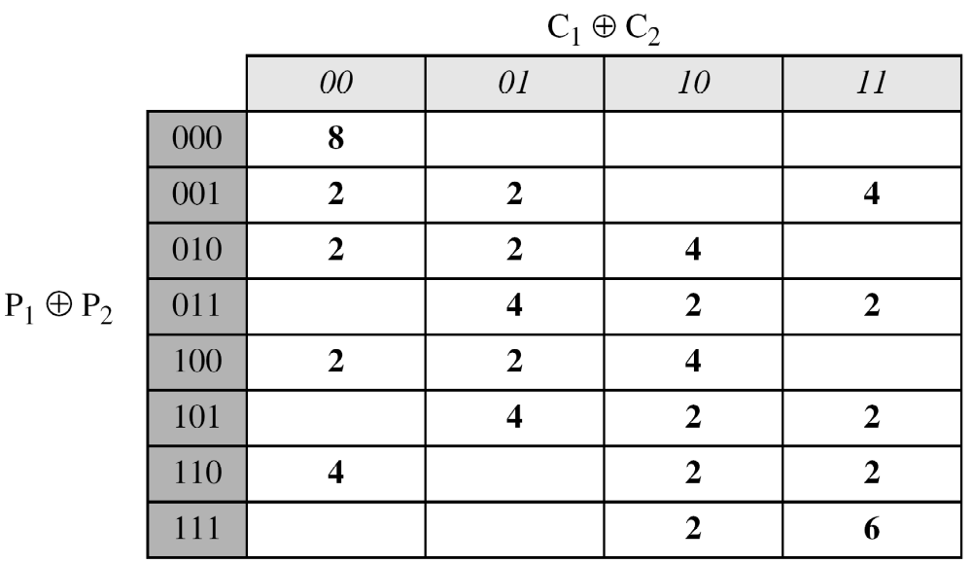
P1 ⊕ P2 = 001; K=101
X1 ⊕ X2 C1 ⊕ C2
001⊕000➔ 100⊕101 ➔ 01 ⊕ 00 = 01
000⊕001➔ 101⊕100 ➔ 00 ⊕ 01 = 01
010⊕011➔ 111⊕110 ➔ 00 ⊕ 11 = 11
100⊕101➔ 001⊕000 ➔ 00 ⊕ 11 = 11
101⊕100➔ 000⊕001 ➔ 11 ⊕ 00 = 11
011⊕010➔ 110⊕111 ➔ 11 ⊕ 00 = 11
110⊕111➔ 011⊕010 ➔ 10 ⊕ 10 = 00
111⊕110➔ 010⊕011 ➔ 10 ⊕ 10 = 00
Probabilistic relationship as shown in Table
B C Dhara, Dept. of IT, JU

Slide 57
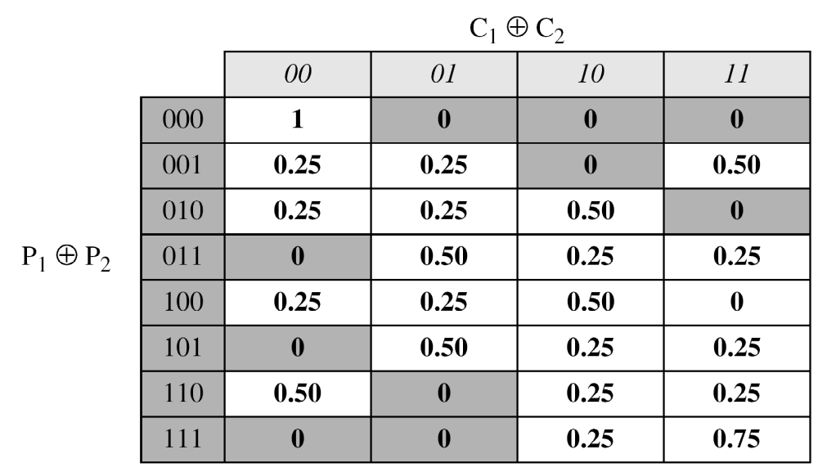
Differential distribution table
B C Dhara, Dept. of IT, JU

Slide 58
Differential attack
if P₁ ⊕ P₂ = 001, then C₁ ⊕ C₂ = 11 with the probability of 0.50 (50 percent)
If assume C₁ = 00 and gets P₁ = 010 (chosen-ciphertext attack). She also tries C₂ = 11 and gets P₂ = 011 (another chosen-ciphertext attack). Now she tries to work backward, based on the first pair, P₁ and C₁,
X₁=101 ➔ K= X₁ ⊕ P₁ = 111
The two tests confirm that K = 011 or K =101.
B C Dhara, Dept. of IT, JU

Slide 59
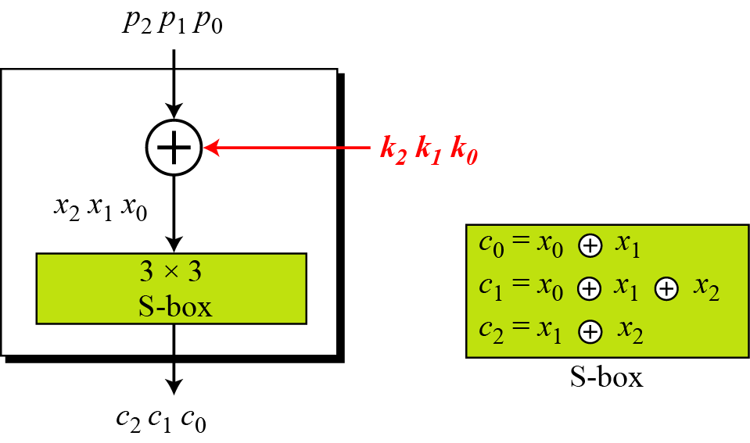
Linear cryptanalysis (contd…)
A simple cipher with linear S-box
B C Dhara, Dept. of IT, JU

Slide 60
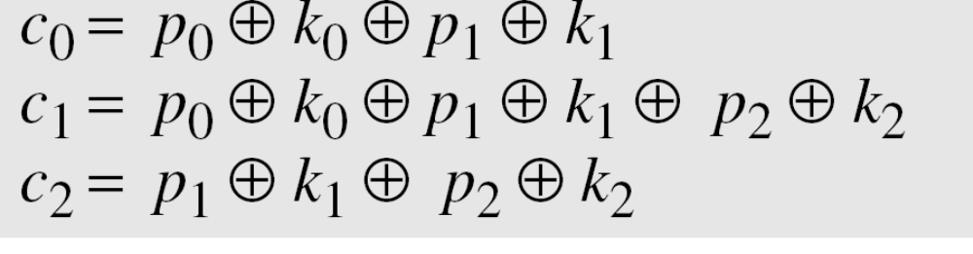
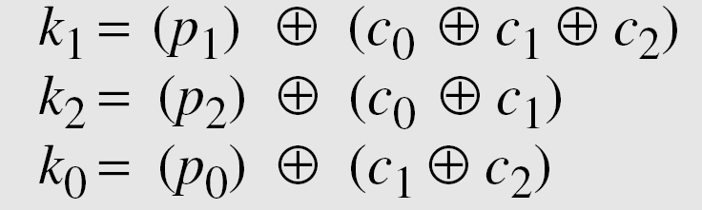
simple cipher with linear S-box (contd…)
This means that three known-plaintext attacks can find the values of k₀, k₁, and k₂ .
B C Dhara, Dept. of IT, JU

Slide 61
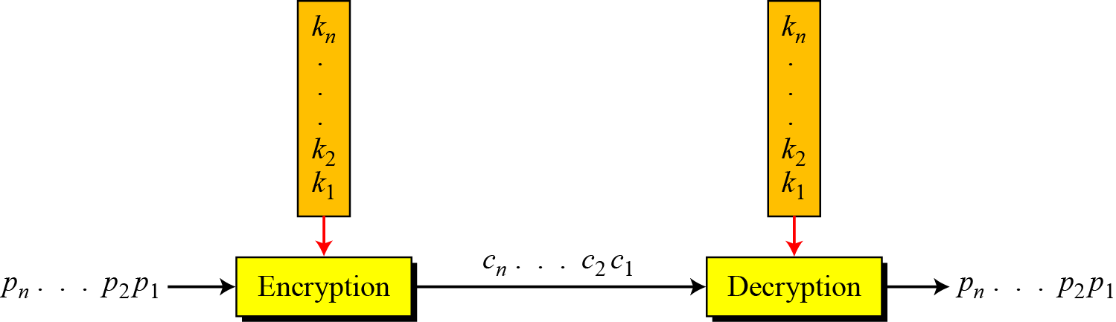
MODERN STREAM CIPHERS
In a modern stream cipher, encryption and decryption are done r bits at a time.
We have a plaintext bit stream P = p_{n}…p₂ p₁, a ciphertext bit stream
C = c_{n}…c₂ c₁, and a key bit stream K = k_{n}…k₂ k₁, in which p_{i} , c_{i} , and k_{i} are r-bit words c_{i} ,=E(k_{i}, p_{i} ) and p_{i} =D(k_{i}, c_{i})
Two important concepts:
Synchronous Stream Ciphers
Nonsynchronous Stream Ciphers
B C Dhara, Dept. of IT, JU

Slide 62
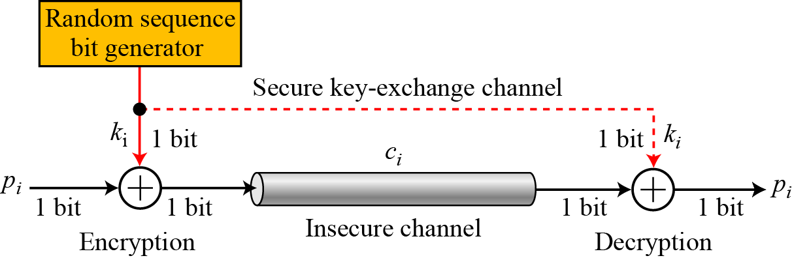
Synchronous Stream Ciphers
In a synchronous stream cipher the key is independent of the plaintext or ciphertext.
One time pad
  The simplest and most secure type of synchronous stream cipher is called the one time pad
  Random key stream is used and both in encryption and decryption 1-bit XOR executed
B C Dhara, Dept. of IT, JU

Slide 63
Notes on one time pad
An adversary cannot guess the key or the plaintext and ciphertext statistics
There is no relationship between the plaintext and ciphertext
Cannot break the cipher unless tries all possible random key stream
  which is 2^{n} , if the size of the plaintext is n bits
Main concern, how to communicate the key each time they want to communicate?
  Very difficult to achieve
B C Dhara, Dept. of IT, JU

Slide 64
One time pad (Contd…)
What is the pattern in the ciphertext of a one-time pad cipher in each of the following cases?
a. The plaintext is made of n 0’s.
b. The plaintext is made of n 1’s.
c. The plaintext is made of alternating 0’s and 1’s.
d. The plaintext is a random string of bits.
Solution
Because 0 ⊕ k_{i} = k_{i} , the ciphertext stream is the same as the key stream. If the key stream is random, the ciphertext is also random.
5.<number>

Slide 65
One time pad (Contd…)
Because 1 ⊕ k_{i} = k_{i}’ where k_{i}’ is the complement of k_{i} , the ciphertext stream is the complement of the key stream. If the key stream is random, the ciphertext is also random.
In this case, each bit in the ciphertext stream is either the same as the corresponding bit in the key stream or the complement of it. Therefore, the result is also a random string if the key stream is random.
In this case, the ciphertext is definitely random because the exclusive-or of two random bits results in a random bit.
B C Dhara, Dept. of IT, JU

Slide 66
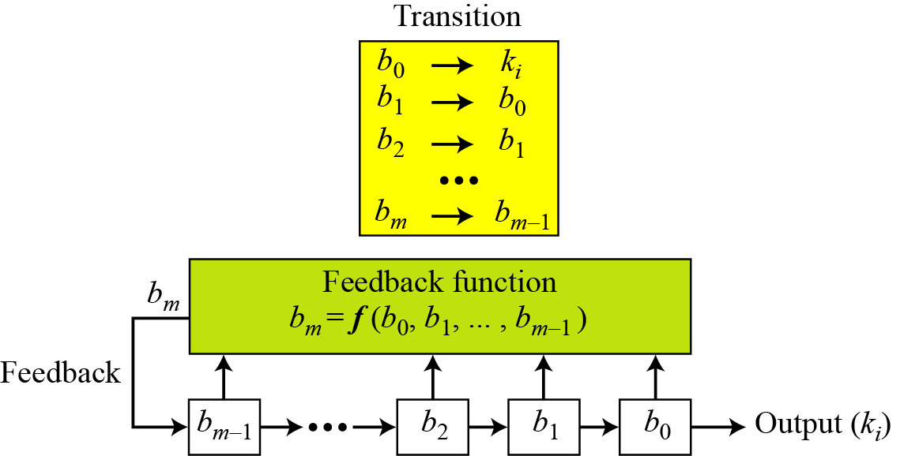
Feedback shift register
B C Dhara, Dept. of IT, JU

Slide 67
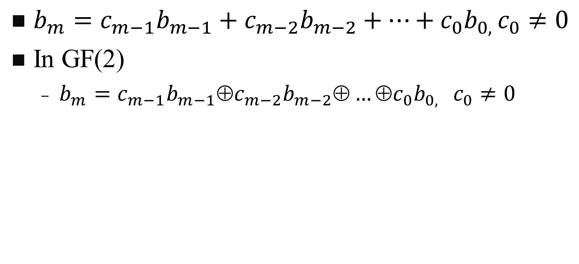
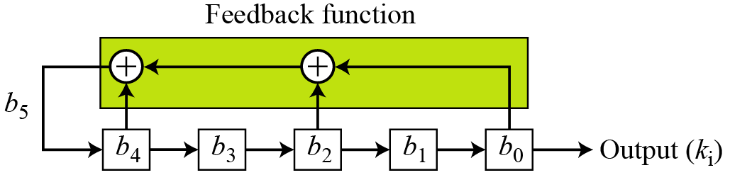
Linear feedback shift register
Create a linear feedback shift register with 5 cells in which
b₅ = b₄ ⊕ b₂ ⊕ b₀ .
B C Dhara, Dept. of IT, JU

Slide 68
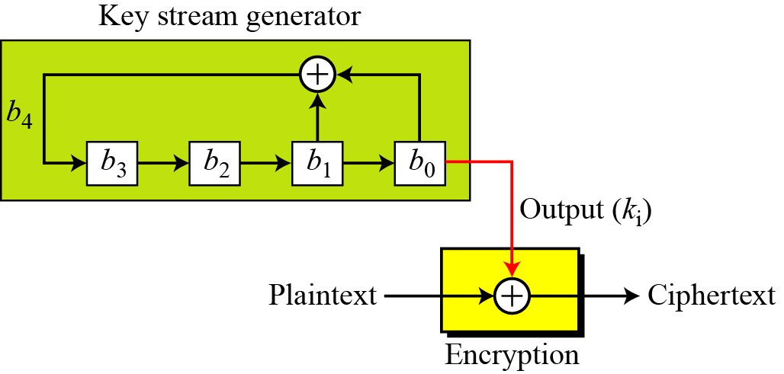
Linear feedback shift register (contd…)
Create a linear feedback shift register with 4 cells in which b₄ = b₁ ⊕ b₀. Show the value of output for 20 transitions (shifts) if the seed is (0001)₂
B C Dhara, Dept. of IT, JU

Slide 69
Key sequence
B C Dhara, Dept. of IT, JU

Slide 70
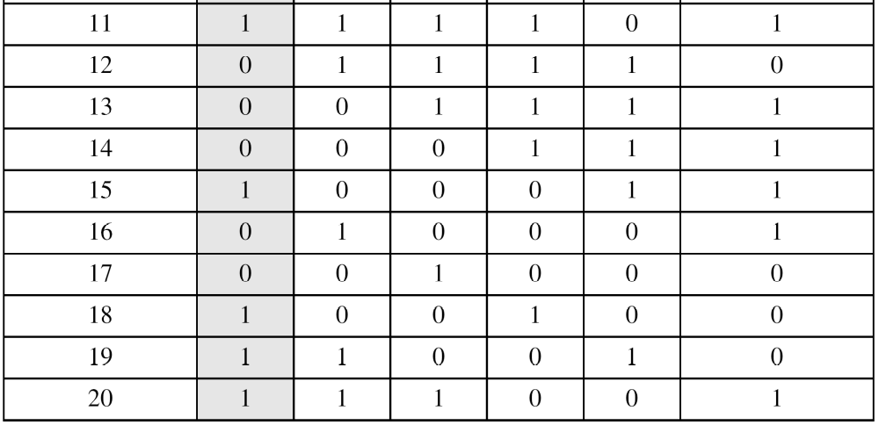
Key sequence (contd…)
B C Dhara, Dept. of IT, JU

Slide 71
Periodicity of LFSR
Note that the key stream is 100010011010111 10001…. This looks like a random sequence at first glance, but if we go through more transitions, we see that the sequence is periodic. It is a repetition of 15 bits as shown below:
The maximum period of an LFSR is to 2^{m} − 1, m bit seed
B C Dhara, Dept. of IT, JU

Slide 72
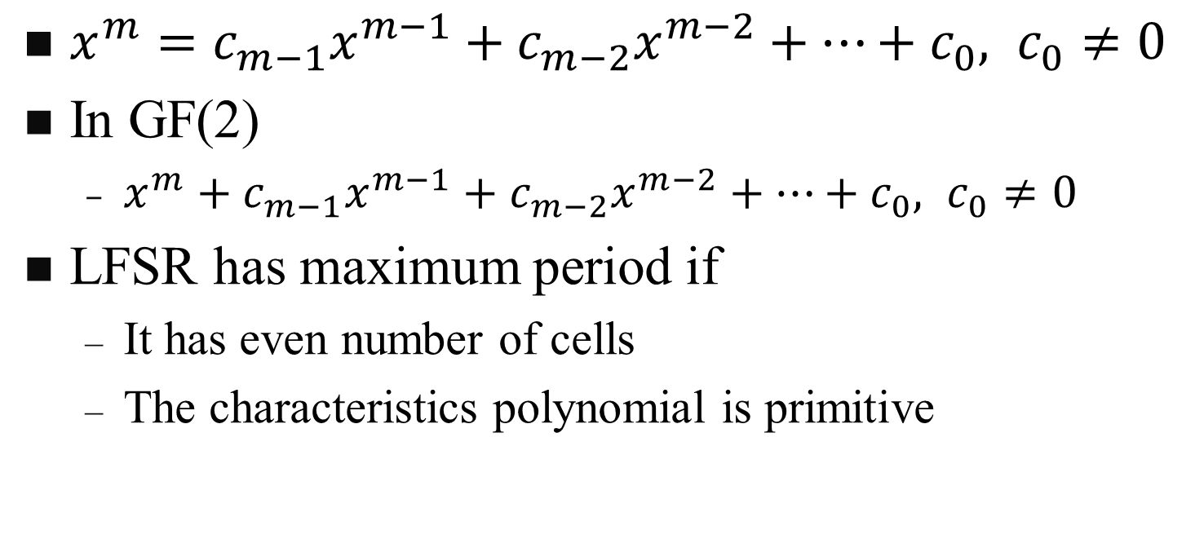
Characteristics polynomial
B C Dhara, Dept. of IT, JU

Slide 73
Attacks on LFSR
LFSR is simple in structure and vulnerable to attacks. Two simple attacks on LFSR are:
  If structure is known, intercepting and analyzing one n-bit ciphertext can predict all future ciphertexts
  If structure is not known, a known plaintext attack of 2n bits to break cipher
B C Dhara, Dept. of IT, JU

Slide 74
Nonlinear Feedback Shift Register
LFSR is vulnerable to attacks due its simple structure
A better stream cipher can be achieved using nonlinear feedback shift register
In NLFSR, b_{m} is a nonlinear function of b_{m-1}, b_{m-2}, b₁, b₀
  b₄ =(b₃ AND b₂) OR (b₁ AND b₀)
NLFSR is not common as no mathematical foundation to make NLFSR with maximum period
B C Dhara, Dept. of IT, JU

